Slide 1
SAS BUSINESS PROJECT
DSA – Metro College of Technology
Presentation by: Ali A. Nathani
Instructor: Ar Kar Min
Date: February 12, 2020

Slide 2
Introduction
Retail store customers’ transactional data were recorded from Jan,2007 to Dec,2008
Scope of analysis will be on Products other than EC90

Slide 3
Business Objectives/Outcomes/Problems
Find the Category and the Item within the Category with the most orders placed, most quantity sold, and most total sales made in order to focus on marketing the correct products to boost profitability
Find the Source with the most orders and the most sales to focus marketing campaigns within that medium

Slide 4
Study Framework - 1
Cust ID
Item Code
Frequency of product
Category
Quantity sold or
Sales Amount
Item Description

Slide 5
Study Frameword - 2
Cust ID
Source
Frequency of product
Category
Quantity sold or
Sales Amount
Item Description

Slide 6
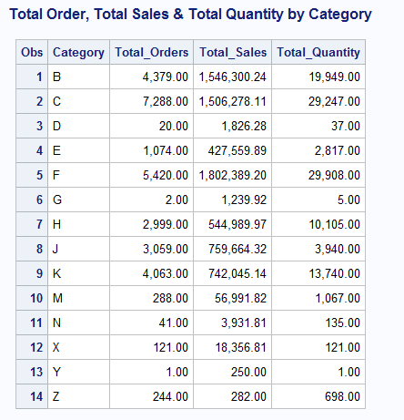
Univariate Descriptive Analysis

Slide 7
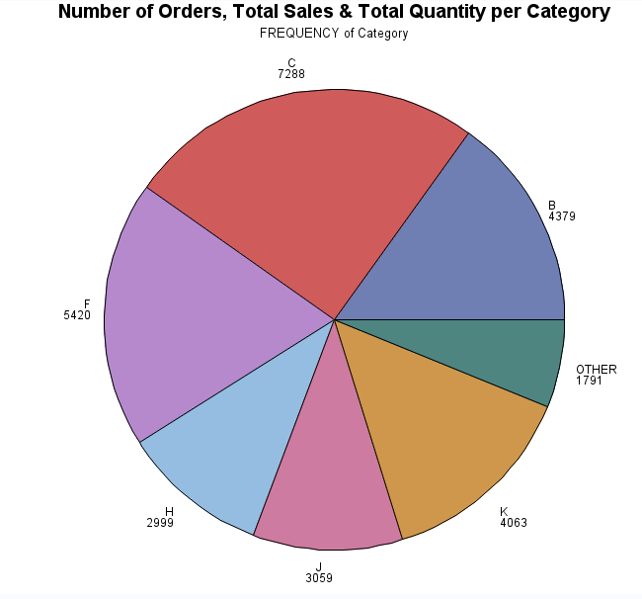
Univariate Descriptive Analysis

Slide 8
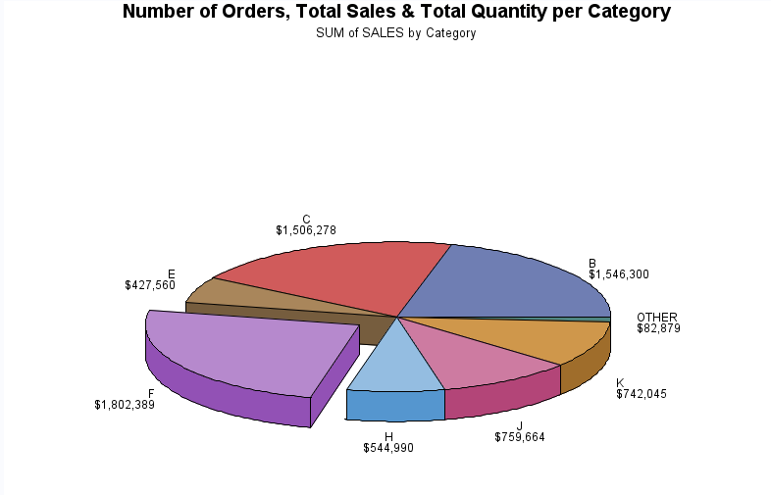
Univariate Descriptive Analysis

Slide 9
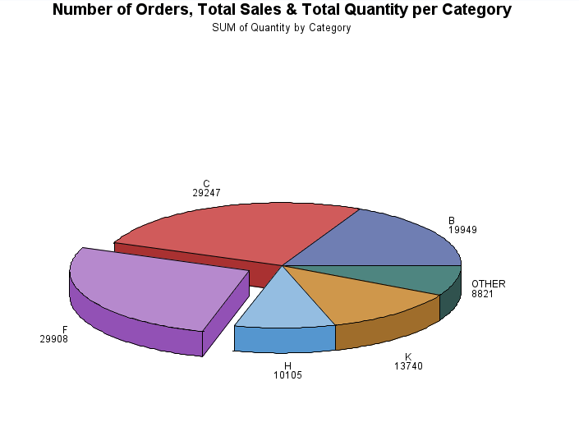
Univariate Descriptive Analysis

Slide 10
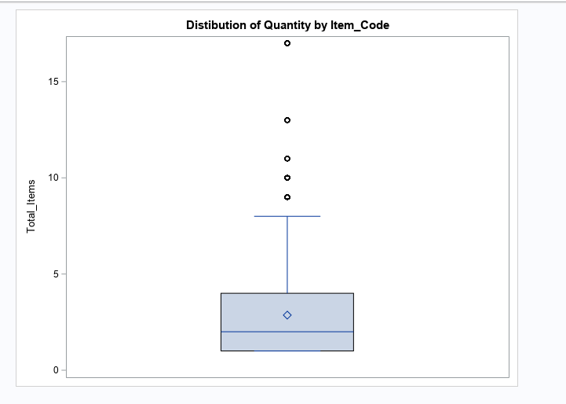
Univariate Analysis

Slide 11
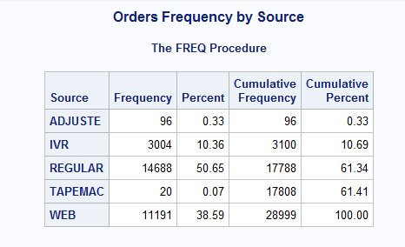
Univariate Analysis

Slide 12
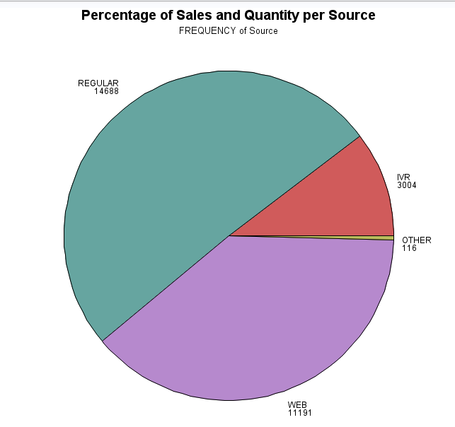
Univariate Analysis

Slide 13
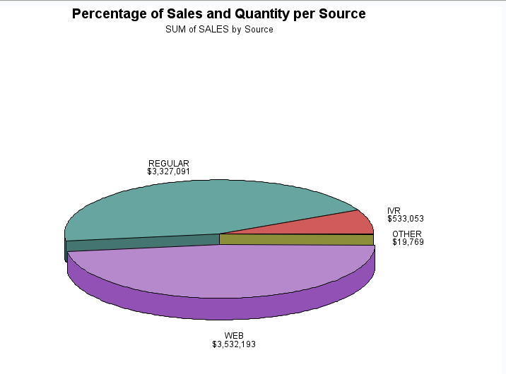
Univariate Analysis

Slide 14
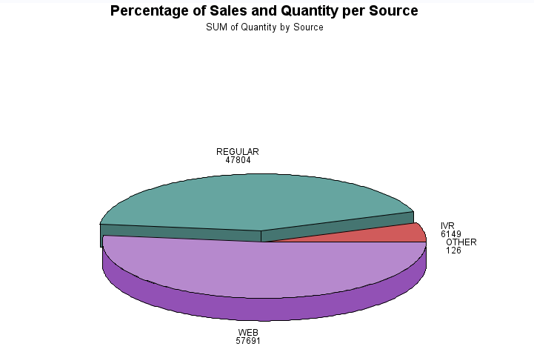
Univariate Analysis

Slide 15
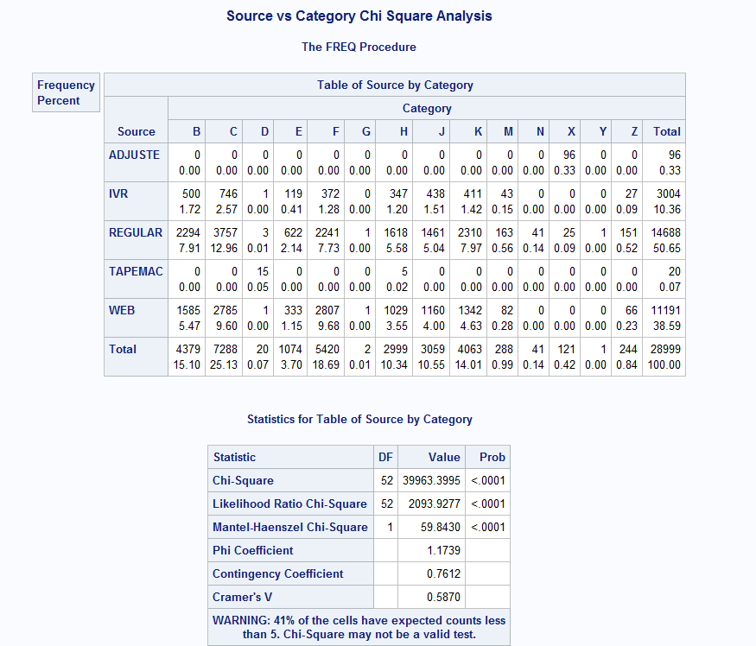
Bi-variate Analysis

Slide 16
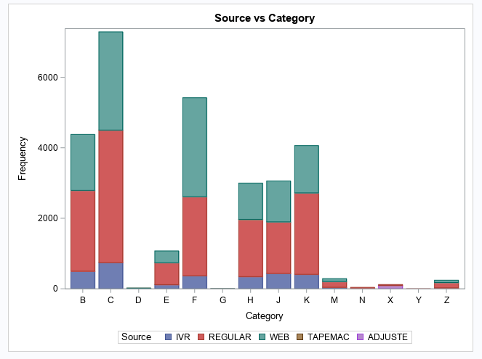
Bi-Variate Analysis

Slide 17
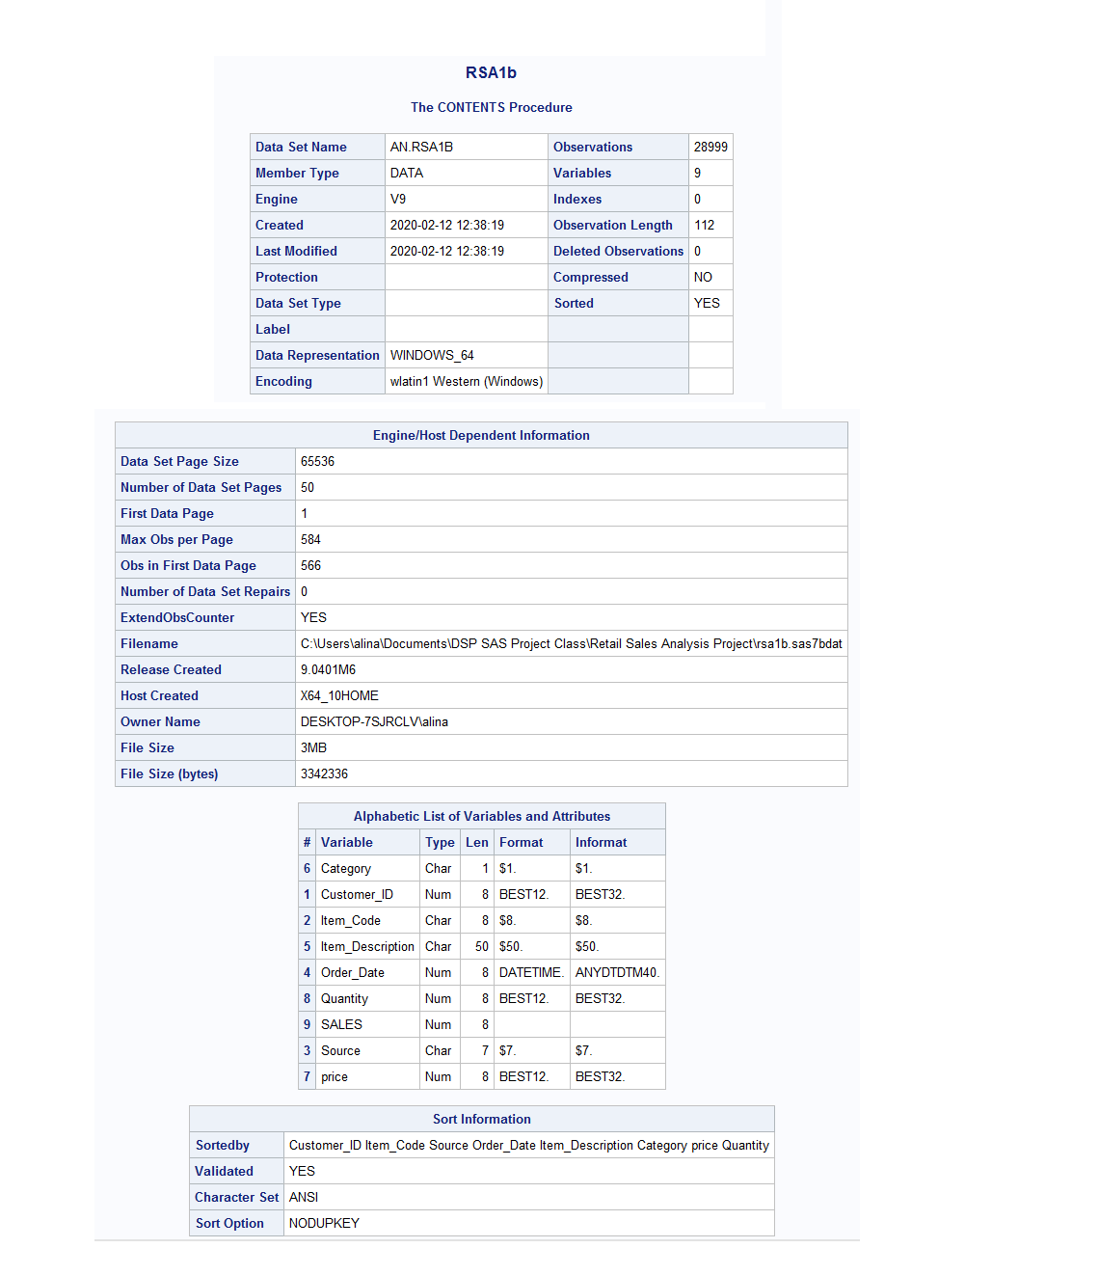
Summary of Variables

Slide 18
SAS SCRIPTS
libname AN "C:\Users\alina\Documents\DSP SAS Project Class\Retail Sales Analysis Project";
*import data to SAS;
PROC IMPORT OUT= AN.RSA1
DATAFILE= "C:\Users\alina\Documents\DSP SAS Project Class\Retail Sales Analysis Project\transactionhistoryforcurrentcustomers.csv"
DBMS=CSV REPLACE;
GETNAMES=YES;
DATAROW=2;
RUN;
*UNDERSTAND YOUR DATA AND ITS PROPERTIES;
TITLE "RSA1a";
PROC CONTENTS DATA = AN.RSA1;
RUN;
TITLE "RSA1a";
PROC UNIVARIATE DATA = AN.RSA1;
RUN;
*DATA VALUE;
PROC PRINT DATA = AN.RSA1 (OBS = 20);
TITLE "RSA1";
RUN;
*CHECK FOR MISSING VALUES;
PROC MEANS DATA = AN.RSA1 N NMISS;
RUN;
DATA AN.RSA1a;
set AN.RSA1;
if cmiss(of _all_) then delete;
run;
*CHECK FOR MISSING VALUES AGAIN;
PROC MEANS DATA = AN.RSA1a N NMISS;
TITLE 'RSA1a';
RUN;
*DUPLICATES;
*COUNT COLS;
TITLE "Count of Distinct Customer IDs in RSA1a";
PROC SQL;
SELECT COUNT(Customer_ID)AS TOTAL_COUNT, COUNT(DISTINCT Customer_ID) AS UNIQUE_COUNT
FROM AN.RSA1a
;
QUIT;

Slide 19
SAS SCRIPTS
*REMOVE DUPLICATE OBSERVATIONS and check count again;
PROC SORT DATA = AN.RSA1a OUT = AN.RSA1a_S dupout=AN.RSA1aDup NODUPKEY;
BY _ALL_;
RUN;
*COUNT AGAIN;
TITLE 'Count of Customer IDs RSA1_S';
PROC SQL;
SELECT COUNT(Customer_ID)AS TOTAL_COUNT, COUNT(DISTINCT Customer_ID) AS UNIQUE_COUNT
FROM AN.RSA1a_s
;
QUIT;
*FEATURE GENERATION FOR ;
*create sales columns in RSA1 ;
PROC SQL ;
CREATE TABLE AN.RSA1b AS
SELECT *, PRICE*QUANTITY AS SALES
FROM AN.RSA1a_s
;
QUIT;
TITLE 'RSA1b';
PROC CONTENTS data = AN.RSA1b; run;
TITLE 'RSA2b';
PROC CONTENTS data = AN.RSA2b; run;
*SELECT VARIABLES IDENTIFIED IN YOUR STUDY FRAMEWORK;
*Total Sales;
TITLE ' Total Sales for RSA1b';
PROC SQL;
SELECT sum(Sales)as TOTAL_Sales format=comma20.2
FROM AN.RSA1b
;
QUIT;

Slide 20
SAS SCRIPTS
*Sales by Item Code and by Category;
/*each group*/
/* 'Sales by Category';*/
PROC SQL;
CREATE TABLE AN.RSA1Category AS
SELECT Category, COUNT(Customer_ID) format=comma20.2 AS Total_Orders, sum(Sales) format=comma20.2 AS Total_Sales, sum(Quantity) format=comma20.2 AS Total_Quantity
FROM AN.RSA1b
GROUP BY Category
ORDER BY Category;
QUIT;
proc print data = AN.RSA1Category;
TITLE 'Total Order, Total Sales & Total Quantity by Category'; run;
TITLE "Number of Orders, Total Sales & Total Quantity per Category";
PROC GCHART DATA = AN.RSA1b;
format sales dollar20.;
PIE Category
;
RUN;
pie3d Category / sumvar=Sales
explode="F";
run;
pie3d Category / sumvar=Quantity
explode="F";
run;
quit;
/*title 'in Category C, which products have most orders';*/
PROC SQL;
CREATE TABLE AN.RSA1MostOrderItem AS
SELECT *, COUNT(Item_Code) AS Total_Items, sum(Sales) format=comma20.2 AS Total_Sales, sum(Quantity) format=comma20.2 AS Total_Quantity
FROM AN.RSA1b
Where Category = 'C'
GROUP BY Item_Code
ORDER BY Total_Items DESC
;
QUIT;
proc sgplot data = AN.RSA1MostOrderItem;
vbox Total_Items;
title 'Distibution of Quantity by Item_Code';
run;

Slide 21
SAS SCRIPTS
/*Distribution of orders & sales across Source*/
title "Orders Frequency by Source";
proc freq data =AN.RSA1b;
table Source;
run;
TITLE "Percentage of Sales and Quantity per Source";
PROC GCHART DATA = AN.RSA1b;
format sales dollar20.;
PIE Source
;
RUN;
pie3d Source / sumvar=Sales
explode="WEB";
run;
pie3d Source / sumvar=Quantity
explode="REGULAR";
run;
quit;
*BIVARIATE ANALYSIS
*chi square analysis;
PROC FREQ DATA = AN.RSA1b;
TITLE 'Source vs Category Chi Square Analysis';
TABLE Source* Category/CHISQ NOROW NOCOL ; *CAN KEEP PERCENT, DO NOT INCLUDE NOPERCENT OR USE NOFREQ FOR ONLY PERCENT;
RUN;
*STACKED BAR CHART;
PROC SGPLOT DATA = AN.RSA1b;
TITLE 'Source vs Category ';
VBAR CATEGORY/GROUP=SOURCE;
RUN;

